Slide 1



Slide 2
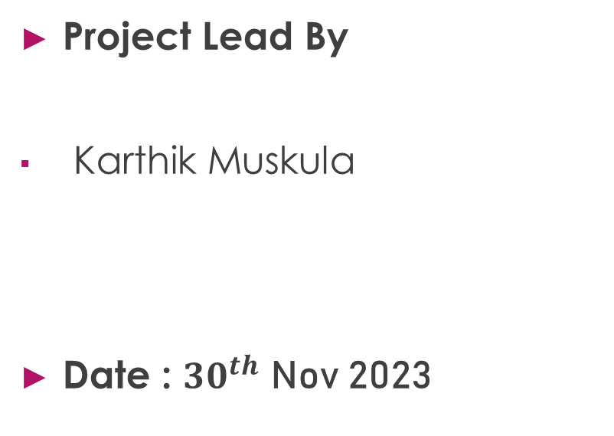
Bankruptcy Prevention Project
Project Team Members
1. Vrushali Jadhav
2. Sonali Gajbhiye
3. Tejas A G
4. Chetan More
5. Sandeep C
Project Lead By
Karthik Muskula
Date : ${30}^{th}$ Nov 2023

Slide 3

Contents
What is Bankruptcy?
Business Objective
Data set Details
EDA (Exploratory Data Analysis)
Visualization
Model Building
Model Evaluation
Deployment
Challenges Faced During Project

Slide 4
What is Bankruptcy?
Bankruptcy is a legal proceeding carried out to free individuals or businesses from their debts.
Creditors still have an opportunity for repayment with the bankruptcy process.
Bankruptcy is handled in federal courts, and rules are outlined in the U.S. Bankruptcy Code.
A bankruptcy will stay on your credit reports for a number of years and make it more difficult to borrow in the future.

Slide 5
Business Problem & Business Objective
.

Slide 6
Business Problem & Business Objective
Business Problem :
To predict the business or a company goes bankrupt or not with different risks factors.
Business Objective :
This is a classification project, since the variable to predict is binary (bankruptcy or non-bankruptcy). The goal here is to model the probability that a business goes bankrupt from different features.

Slide 7

Data Set Details
The data file contains 7 features about 250 companies.
The dataset includes the following variables :
industrial_risk: 0=low risk, 0.5=medium risk, 1=high risk.
management_risk: 0=low risk, 0.5=medium risk, 1=high risk.
financial_flexibility: 0=low flexibility, 0.5=medium flexibility, 1=high flexibility.
credibility: 0=low credibility, 0.5=medium credibility, 1=high credibility.
competitiveness: 0=low competitiveness, 0.5=medium competitiveness, 1=high competitiveness.
operating_risk: 0=low risk, 0.5=medium risk, 1=high risk.
class: bankruptcy, non-bankruptcy (target variable).

Slide 8
EDA (Exploratory Data Analysis)

Slide 9
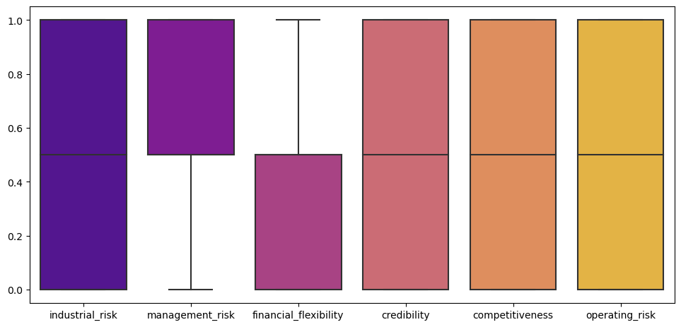
Data Visualization
Here we used Boxplot to check Outliers .
There are no any outliers in our data.
It means our data is clean & we can perform EDA with the data.

Slide 10
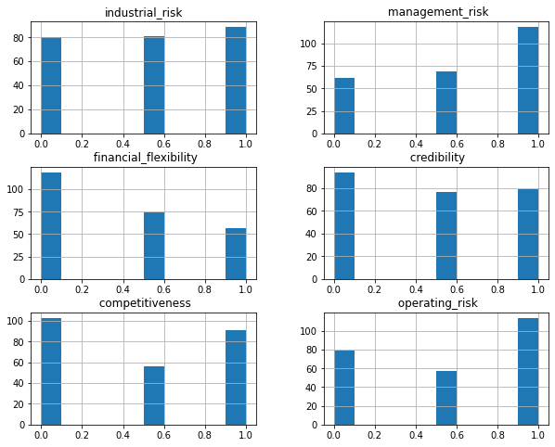
Data Visualization
There is almost same data for industrial risk & credibility.
There is more data for high risk in management risk.
There is more data we have for low risk in financial flexibility.
There is almost same data for low & high competitiveness.
There is more data for high risk in operating risk.

Slide 11
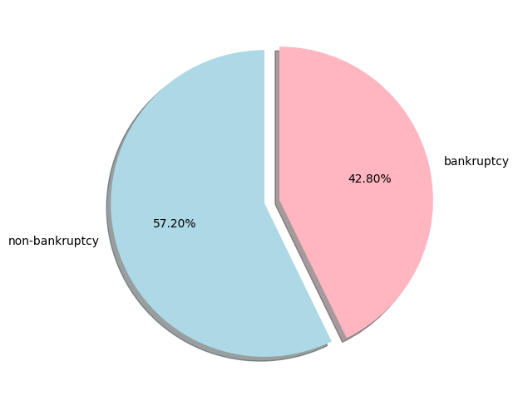
Data Visualization
In this data set we have 57.2% data belongs to non-bankruptcy & 42.8% data belongs to bankruptcy.
We have more observations for non-bankruptcy.

Slide 12
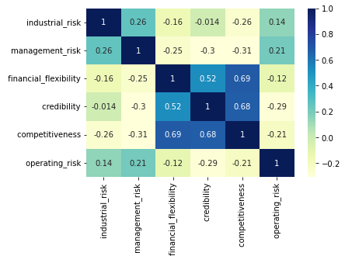
Data Visualization
Credibility & financial_flexibility are correlated with each other.
Competitiveness & financial_flexibility are also correlated with each other.
Credibility & competitiveness are also mostly correlated with each other.
It means the data in the above features are almost have same properties.

Slide 13
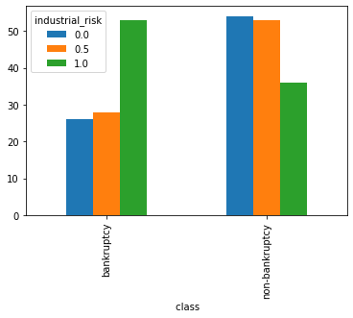
Industrial Risk by Class
When industrial risk is high then company goes with bankruptcy.
When industrial risk is low & medium company goes with non-bankruptcy.

Slide 14
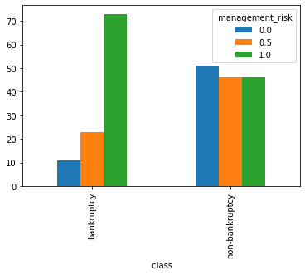
Management Risk by Class
When management risk is high then company goes with bankruptcy.
When management risk is low company goes with non-bankruptcy.

Slide 15
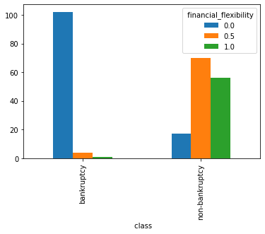
Financial flexibility by Class
When financial flexibility is low then company goes with bankruptcy.
When financial flexibility is high & medium company goes with non-bankruptcy.

Slide 16
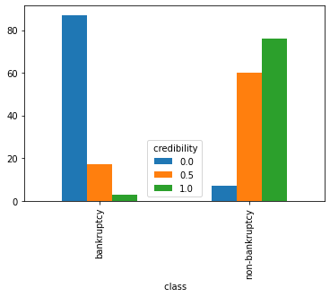
Credibility by Class
When credibility is low then company goes with bankruptcy.
When credibility is high & medium company goes with non-bankruptcy.

Slide 17
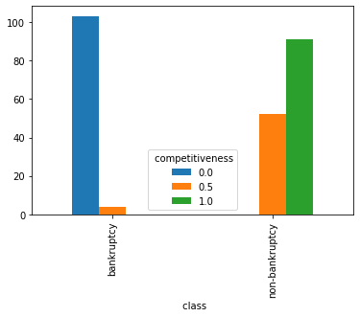
Competitiveness by Class
When competitiveness is low then company goes with bankruptcy.
When competitiveness is high & medium company goes with non-bankruptcy.

Slide 18
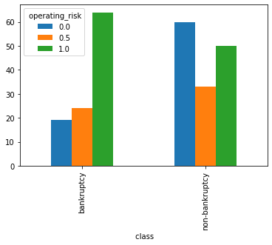
Operating Risk by Class
When operating risk is high then company goes with bankruptcy.
When operating risk is low company goes with non-bankruptcy.

Slide 19
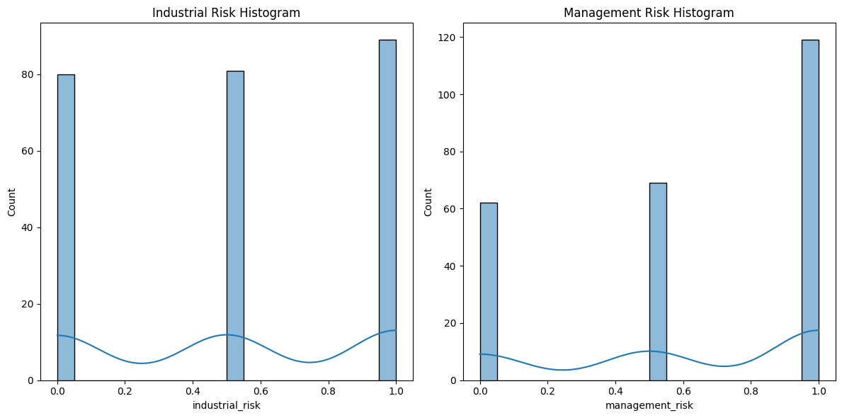
Histograms for ‘industrial_risk’ and ‘management_risk’
Most of the industrial_risk count is equal to 80 or the high risk count is more compare to other two.
In the management_risk, there is a high risk count of around 120 compared to low and medium risk which has count between 60-70.

Slide 20
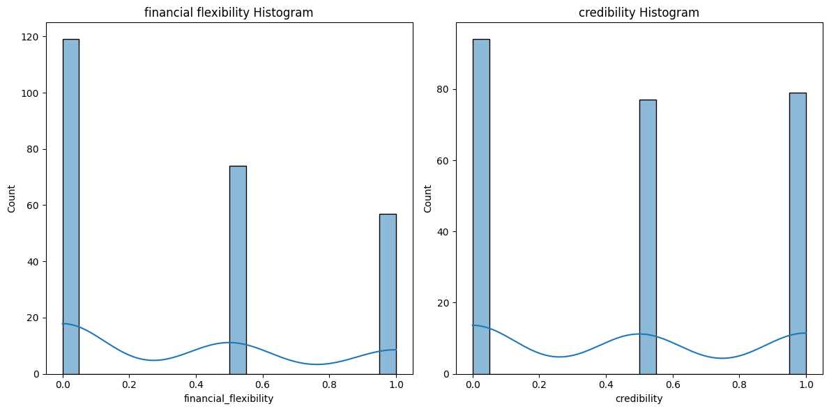
Histograms for ‘financial_flexibility’ and ‘credibility’
There is a more count of low risk in finiancial_flexibility.
In credibility, the count of low risk has around 100 and the counts of low and medium risk are between 70-80.

Slide 21
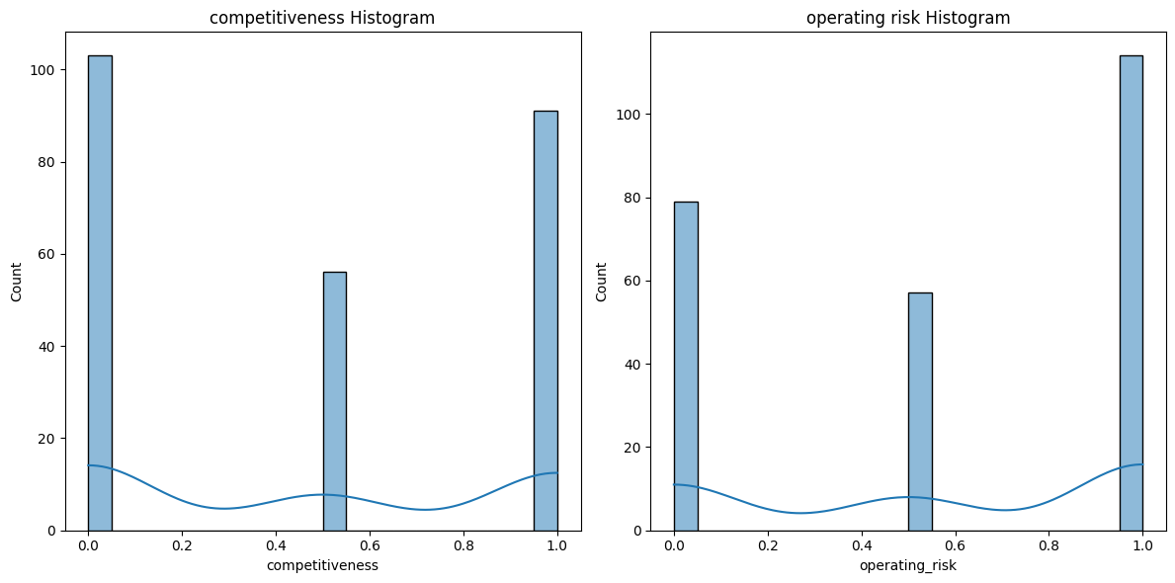
Histograms for ‘competitiveness’ and ‘operating risk’
In competitiveness, there is almost equal count of low risk and as well as high risk.
There is high risk count in operating_risk.

Slide 22
Insights from the EDA
There is no any null entries & outliers in the data, so we have clean data.
We have more observations for non-bankruptcy class than bankruptcy.
Credibility, competitiveness & financial_flexibility have correlation as mentioned above.
When industrial_risk, management_risk, operating_risk is high, then company goes with bankruptcy .
When financial_flexibility, credibility, competitiveness is low then company goes with bankruptcy.

Slide 23
MODEL BUILDING

Slide 24
Data Preprocessing
Divide the dataset in two subset one for Training the model and another for Testing the performance.
The common split ratio which is 80% for Training and 20% for Testing (Mention “test_size=0.2”).
The importance of data splitting for evaluating how well the model for generalize the new or unseen data.
Mention “random_state = 42” setting the random state ensures the reproducibility ,meaning that running the code multiple times will produce the same split.

Slide 25
Model Selection(code overview)
# Model selection and training:
from sklearn.linear_model import LogisticRegression
# Now you can use Logistic Regression algorithm,
model = LogisticRegression()
model.fit(X_train, Y_train)
LogisticRegression()
LogisticRegression(random_state=42)

Slide 26
Insights of Model Selection
Features (x) and target variable (y) are separated with an 80-20 train-test-split.
Logistic Regression is chosen for model building.
Logistic Regression model is trained on the training data using the fit method.
We have trained and tested the dataset with all the classification algorithms and with the basis of accuracy_score and confusion matrix scores we have chosen Logistic Regression classifier for the final Model deployment.

Slide 27
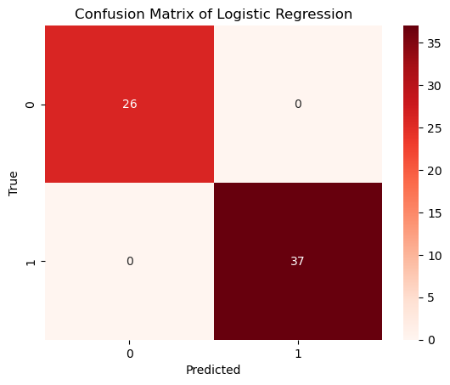
Model Building using Logistic Regression
Accuracy Score : 1.0
F1 Score : 1.0
Precision : 1.0
Recall : 1.0

Slide 28
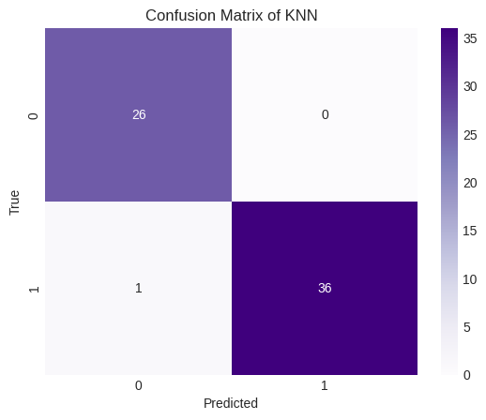
Model Building using KNN
Accuracy Score : 0.98
F1 Score : 0.98
Precision : 1.0
Recall : 0.97

Slide 29
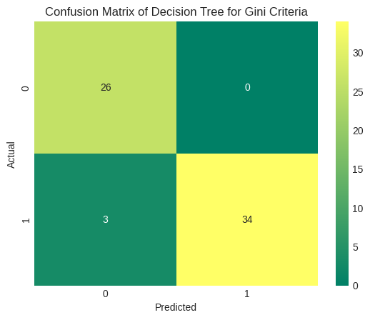
Model Building using Decision Tree
Accuracy Score : 0.95
F1 Score : 0.95
Precision : 1.0
Recall : 0.91

Slide 30
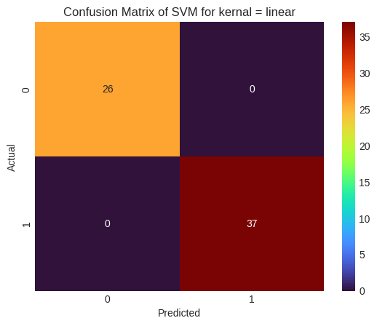
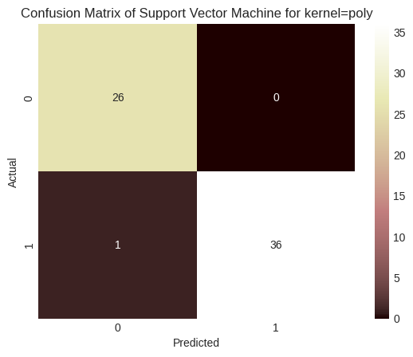
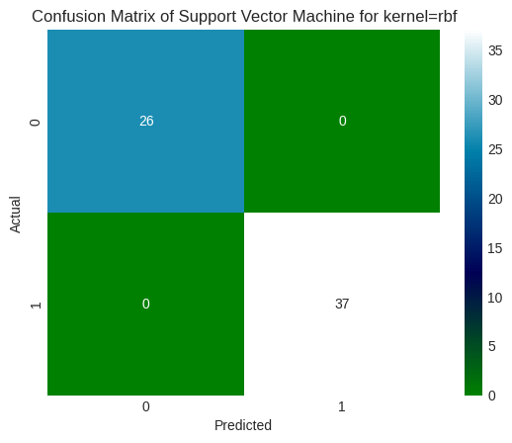
Model Building using Support Vector Machine
Accuracy Score : 1.0
F1 Score : 0.98
Precision : 1.0
Recall : 0.97

Slide 31
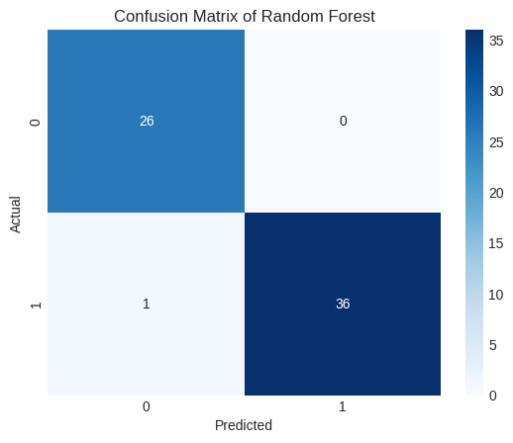
Model Building using Random Forest
Accuracy Score : 0.98
F1 Score : 0.98
Precision : 1.0
Recall : 0.97

Slide 32
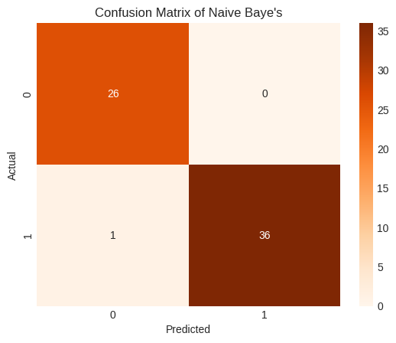
Model Building using Naive Baye’s
Accuracy Score : 0.98
F1 Score : 0.98
Precision : 1.0
Recall : 0.97

Slide 33
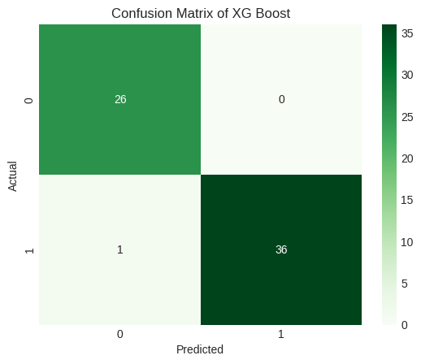
Model Building using XG Boost
Accuracy Score : 0.98
F1 Score : 0.98
Precision : 1.0
Recall : 0.97

Slide 34
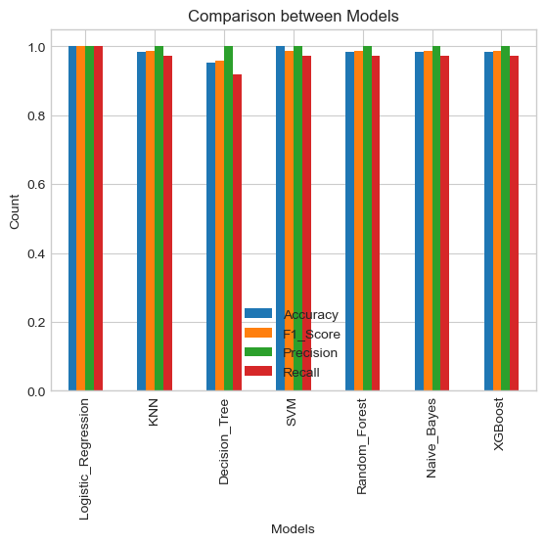

Slide 35
MODEL DEPLOYMENT

Slide 36
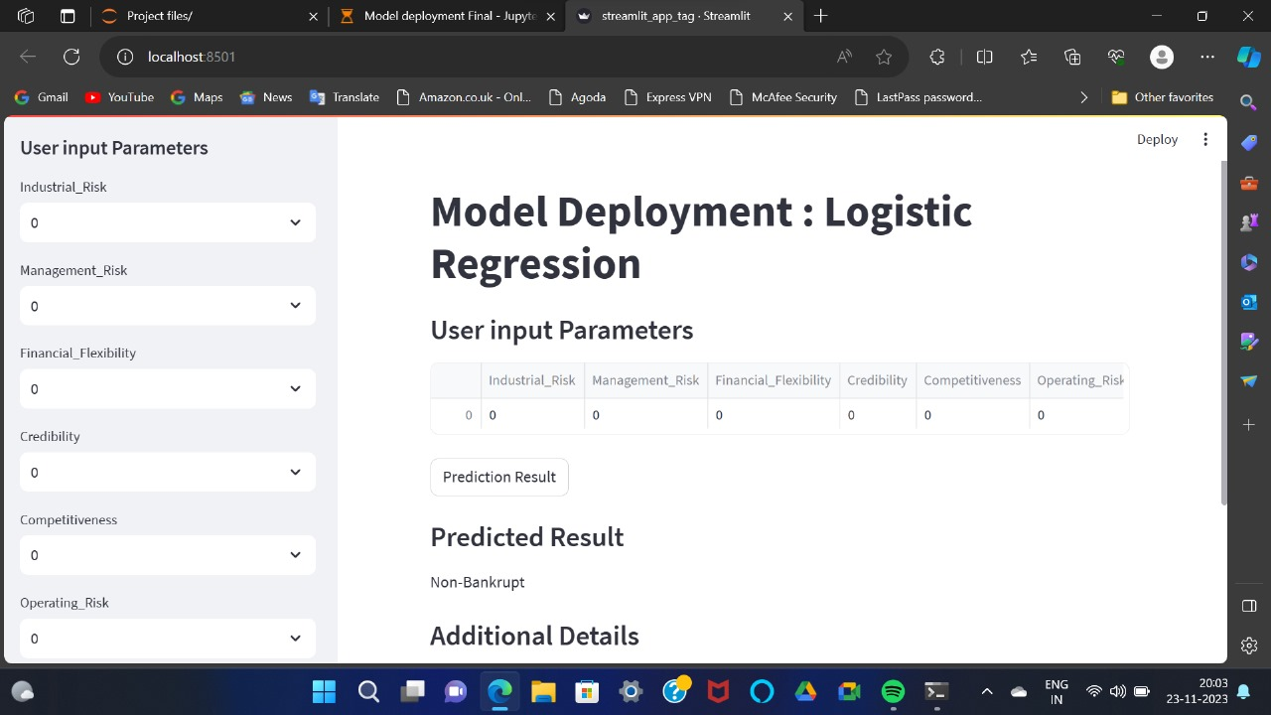

Slide 37
Challenges Faced During Project
1.Understand the Data: Check for missing values, data types, and the distribution of classes you want to predict, preceding space in the data.
2. Choosing the correct machine learning model: It is important to choose the right machine learning model for the task.
3.Visualize Results: Create visualizations to better understand your model's predictions and showcase results.
4. Model Training Challenges:
Issues related to overfitting, underfitting, and hyperparameter tuning.
Highlight the importance of selecting the right evaluation metric.
5. Deployment: Error resolved during deployment.
6.Communicate Findings: Summarize your findings, document your process, and communicate your results. This could be in the form of presentation.

Slide 38
Thank you

